Slide 1
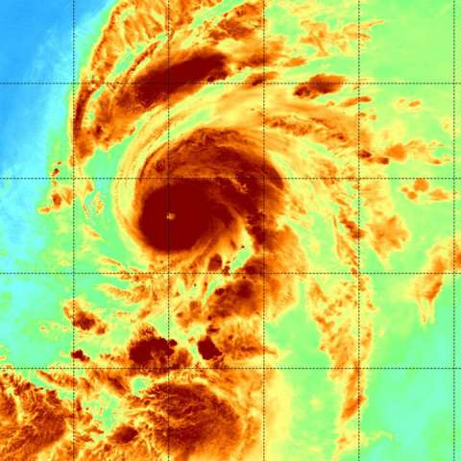
cyclone data analysis IN THE PACIFIC
Ritik ROY
18MM01009
Pre-final year undergraduate
IIT Bhubaneswar

Slide 2
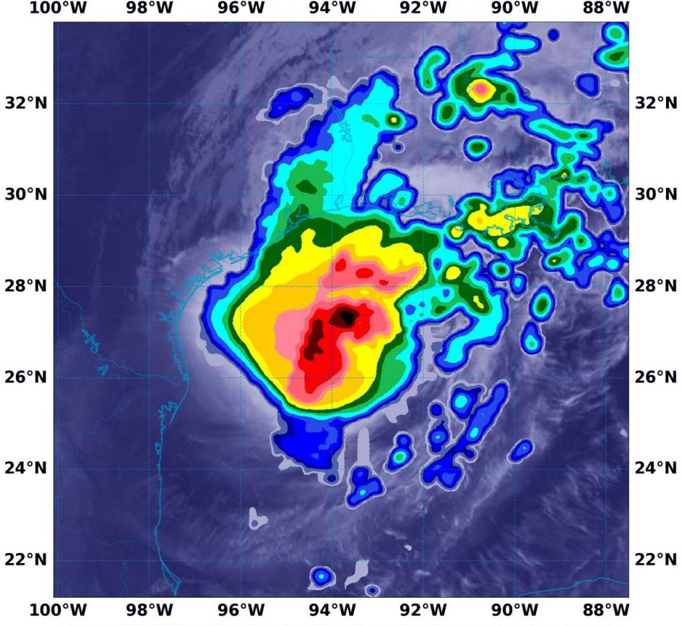
INTRODUCTION
The National Hurricane Centre (NHC) conducts a post-storm analysis of each tropical cyclone in the Atlantic basin (i.e., North Atlantic Ocean, Gulf of Mexico, and Caribbean Sea) and the North Pacific Ocean to determine the official assessment of the cyclone's history.
This analysis makes use of all available observations, including those that may not have been available in real time.
In addition, NHC conducts ongoing reviews of any retrospective tropical cyclone analyses brought to its attention and on a regular basis updates the historical record to reflect changes introduced.

Slide 3






Project Timeline Template
DATA
Hurricanes and Typhoons, NOAA
Location, wind, and pressure of tropical cyclones in Pacific Ocean
Labeling the Data
Variable transformation
Cleaning the data
STATISTICAL ANALYSIS
Frequency analysis
Hurricane heatmap
DATA PREPROCESSING
CLASSIFICATION
MODEL EVALUATION
Compare model parameters like recall, precision, false positive, etc.
Feature selection using Random Forest
prediction by DT, SVM, Naïve Bayes
Prediction accuracy
Data obtained from Kaggle dataset published by NOAA licensed for “Public” usage.
The data is obtained in the CSV format.
Format a document and label the variables.
Finding heatmaps, ranking hurricanes by frequency, hurricane monthly, yearly etc.
Classification into Hurricanes or Typhoons using ,Decision Tree, Random Forrest , Naive Bayes and SVM.
Evaluate the Prediction accuracy by different ML Models

Slide 4
Data Table
Description | Feature
ID | Cyclone ID
Name
Date | Date of occurrence
Time | synoptic times of 0000, 0600, 1200, and 1800
Event | L – Landfall (centre of system crossing a coastline) P – Minimum in central pressure I – An intensity peak in terms of both pressure and maximum wind S – Change of status of the system T – Provides additional detail on the track (position) of the cyclone
Status | Status of the Cyclone
Latitude
Longitude
Maximum Pressure | Maximum pressure for the cyclone
Maximum Wind | Maximum wind speed
Low, Moderator, High Wind NE, NW
Low, Moderator, High Wind SE, SW

Slide 5
Status – Dependent Variable
# Status can be the following types:
# TD – Tropical cyclone of tropical depression intensity (< 34 knots)
# TS – Tropical cyclone of tropical storm intensity (34-63 knots)
# HU – Tropical cyclone of hurricane intensity (> 64 knots)
# EX – Extratropical cyclone (of any intensity)
# SD – Subtropical cyclone of subtropical depression intensity (< 34 knots)
# SS – Subtropical cyclone of subtropical storm intensity (> 34 knots)
# LO – A low that is neither a tropical cyclone, a subtropical cyclone, nor an extratropical cyclone (of any intensity)
# WV – Tropical Wave (of any intensity) # DB – Disturbance (of any intensity)

Slide 6
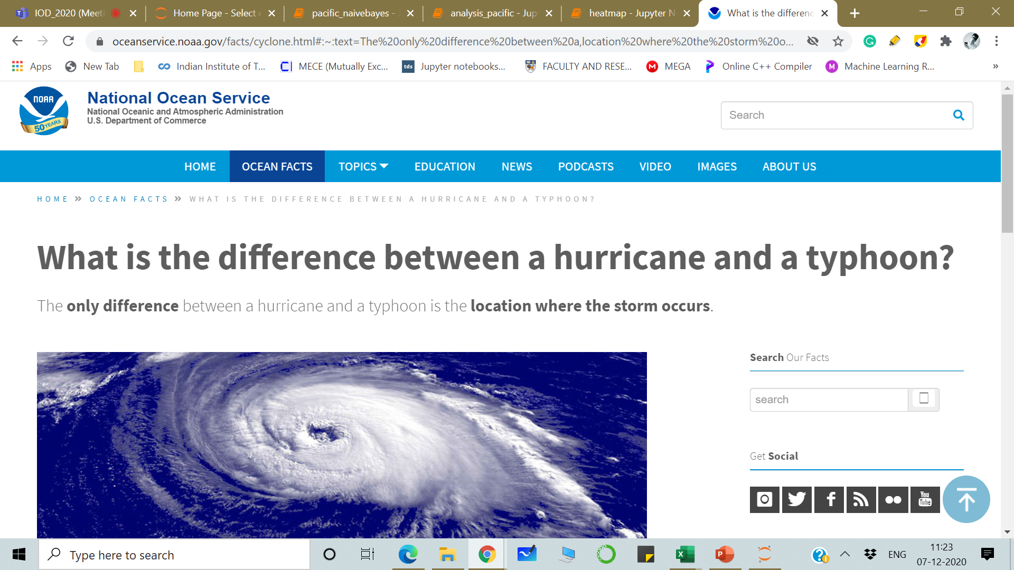
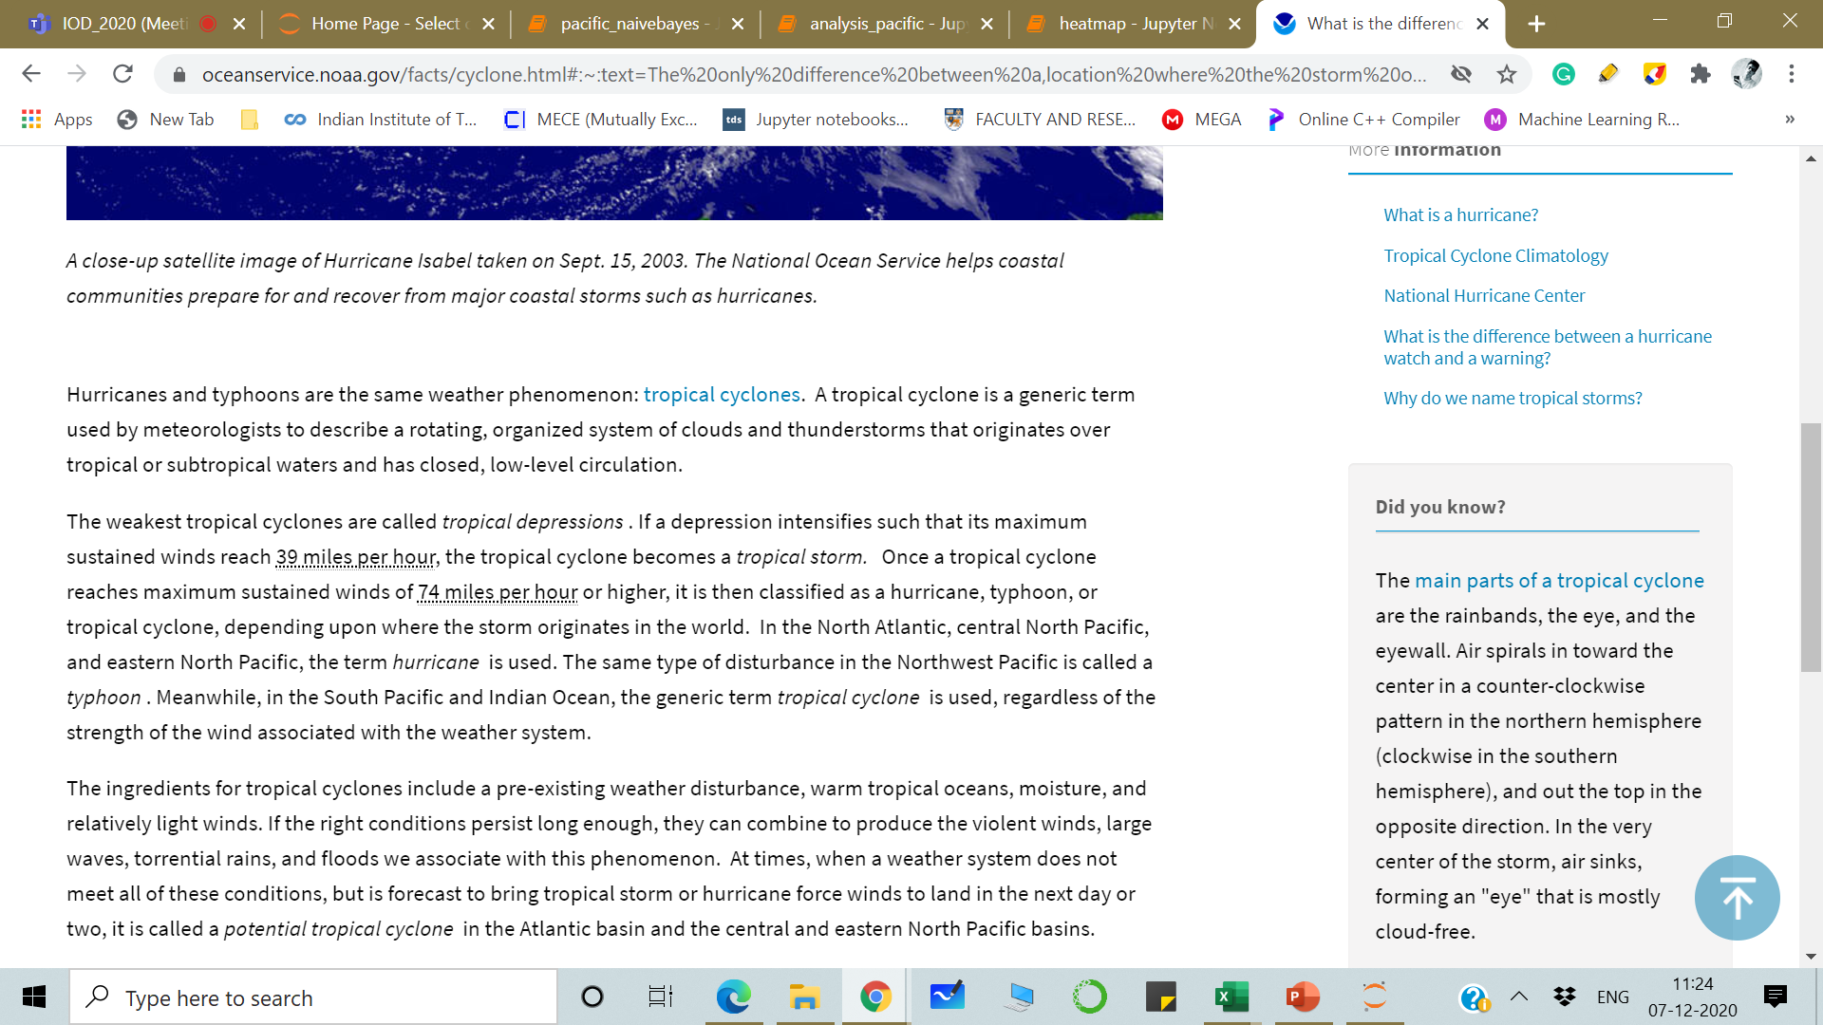

Slide 7
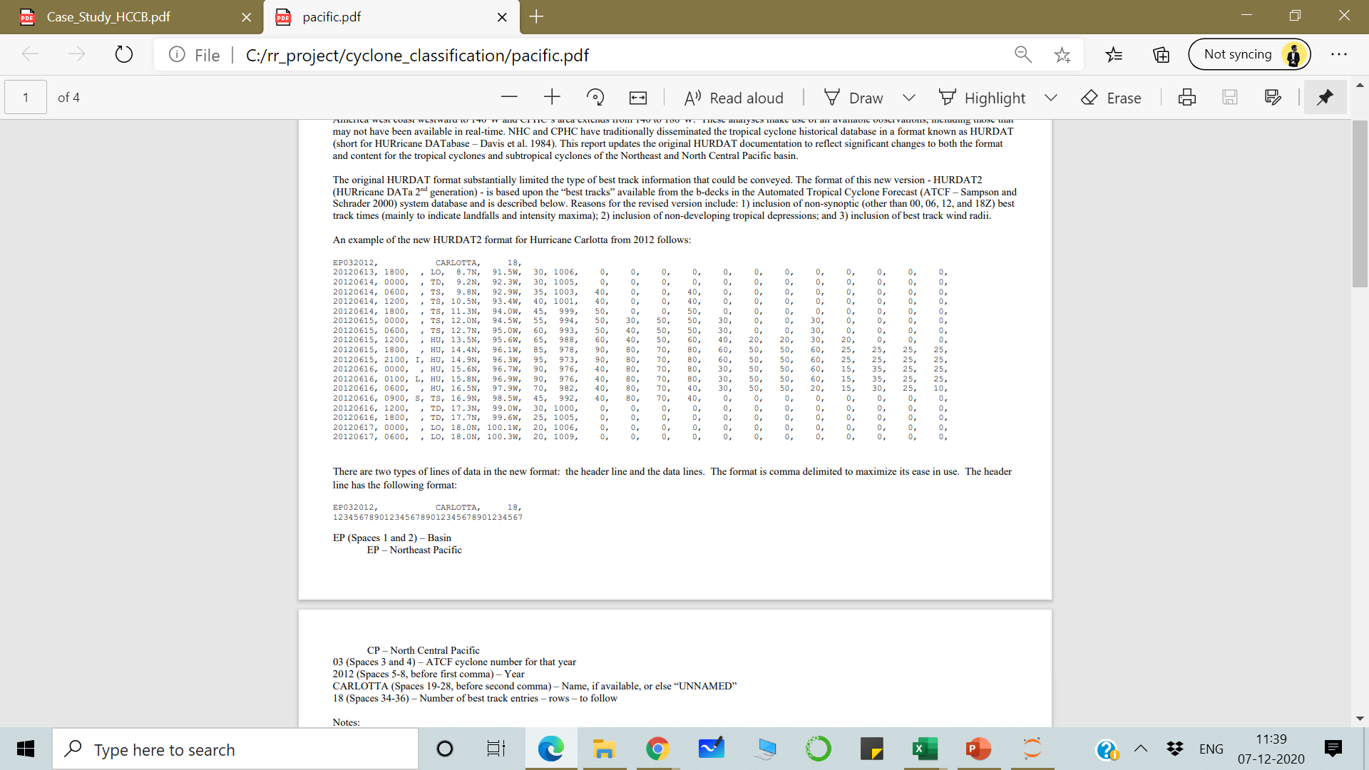
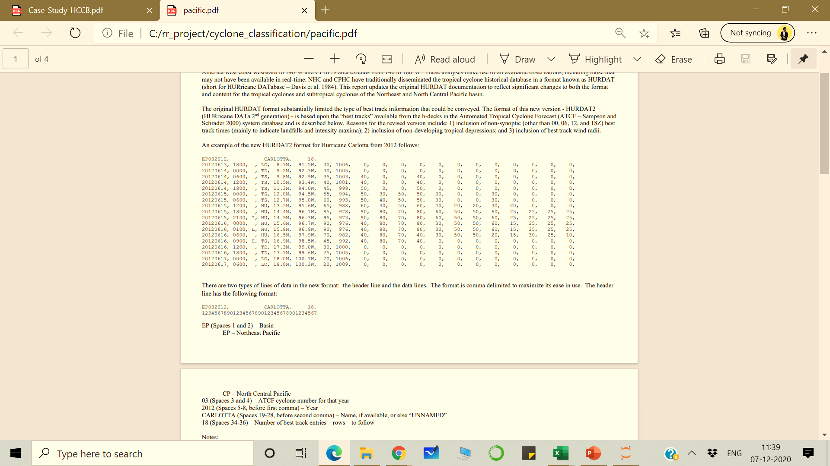
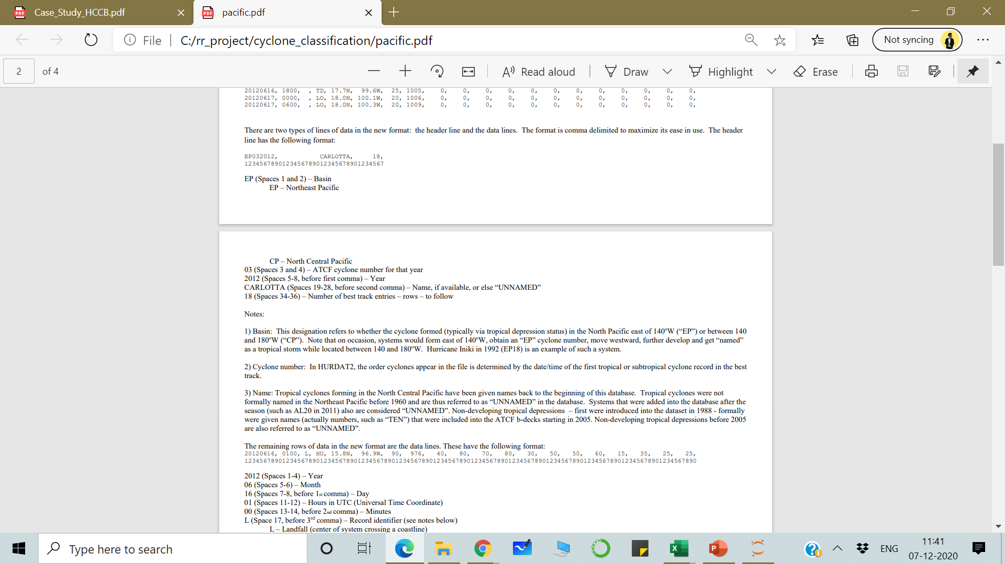
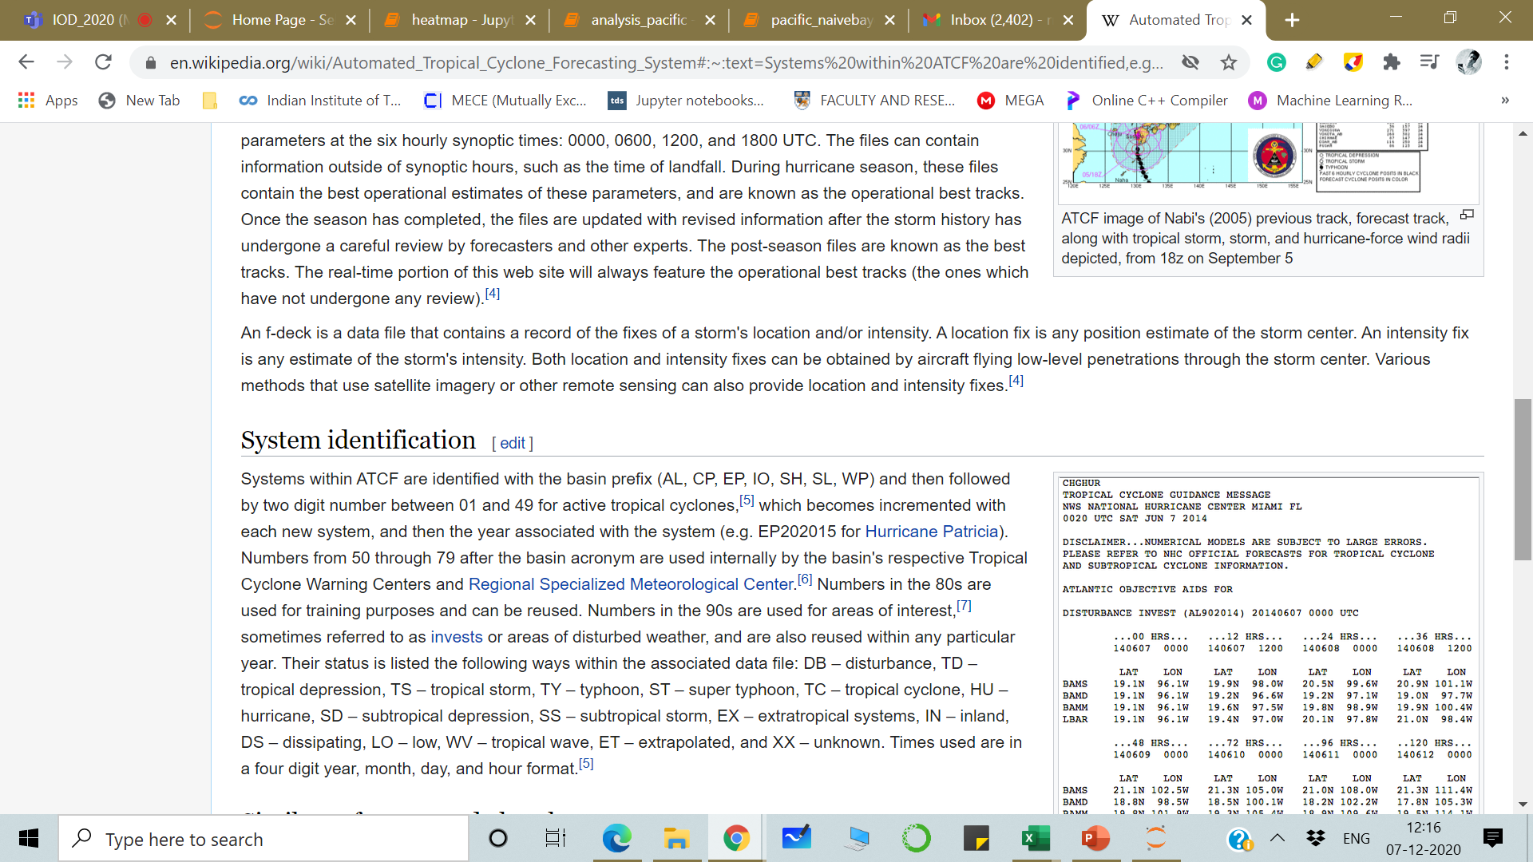

Slide 8
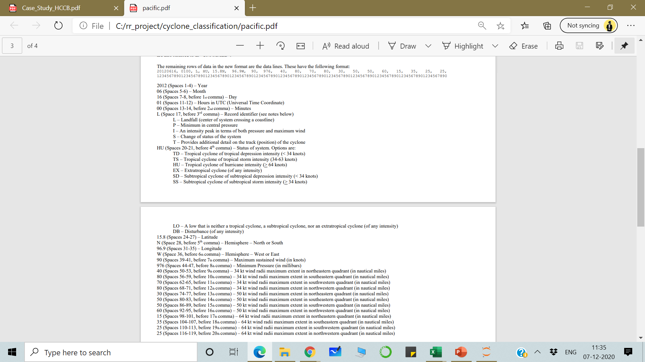

Slide 9
1) Record identifier: This code is used to identify records that correspond to landfalls or to indicate the reason for inclusion of a record not at the standard synoptic times (0000, 0600, 1200, and 1800 UTC). For the years 1989 onward, international landfalls (but not for U.S.’ Hawaii) are denoted with the “L” identifier. The landfall identifier (L) is the only identifier that will appear with a standard synoptic time record. The remaining identifiers (see table above) are only used with a synoptic records to indicate the reason for their inclusion. Inclusion of asynoptic data is at the discretion of the Hurricane Specialist who performed the post storm analysis; standards for inclusion or non-inclusion have varied over time. Identification of asynoptic peaks in intensity (either wind or pressure) may represent either system’s lifetime peak or a secondary peak.
2) Time: Nearly all HURDAT2 records correspond to the synoptic times of 0000, 0600, 1200, and 1800. Recording best track data to the nearest minute became available within the b-decks beginning in 1992 and some tropical cyclones since that year have the landfall best track to the nearest minute.
3) Status: The low status is for cyclones that are not tropical cyclone or subtropical cyclones, nor extratropical cyclones. These typically are assigned at the beginning of a system’s lifecycle and/or at the end of a system’s lifecycle. For the disturbance status, the location given is the approximate position of the lower tropospheric vorticity centre, as the surface centre is not present for this stage.
4) Maximum sustained surface wind: This is defined as the maximum 1-min average wind associated with the tropical cyclone at an elevation of 10 m with an unobstructed exposure. Values are given to the nearest 5 kt and are assigned for every cyclone at every best track time. From 1949 through 1969 the maximum wind values are only crudely estimated (values of “25”, “45”, and “75” are very commonly used), reflecting in part the rudimentary information available in the pre-satellite era for intensity analysis.
5) Central Pressure: These values are given to the nearest millibar. Originally, central pressure best track values were only included if there was a specific observation that could be used explicitly. Missing central pressure values are noted as “-999”. Beginning in 1988 for “EP” and 2001 for “CP”, central pressures have been analysed and included for every best track entry, even if there was not a specific in-situ measurement available.
6) Wind Radii – These values have been best tracked since 2004 and are thus available here from that year forward with a resolution to the nearest 5 nm. Best tracks of the wind radii have not been done before 2004 and are listed as “-999” to denote missing data. Note that occasionally when there is a non-synoptic time best track entry included for either landfall or peak intensity, that the wind radii best tracks were not provided. These instances are also denoted with a “-999” in the database.

Slide 10
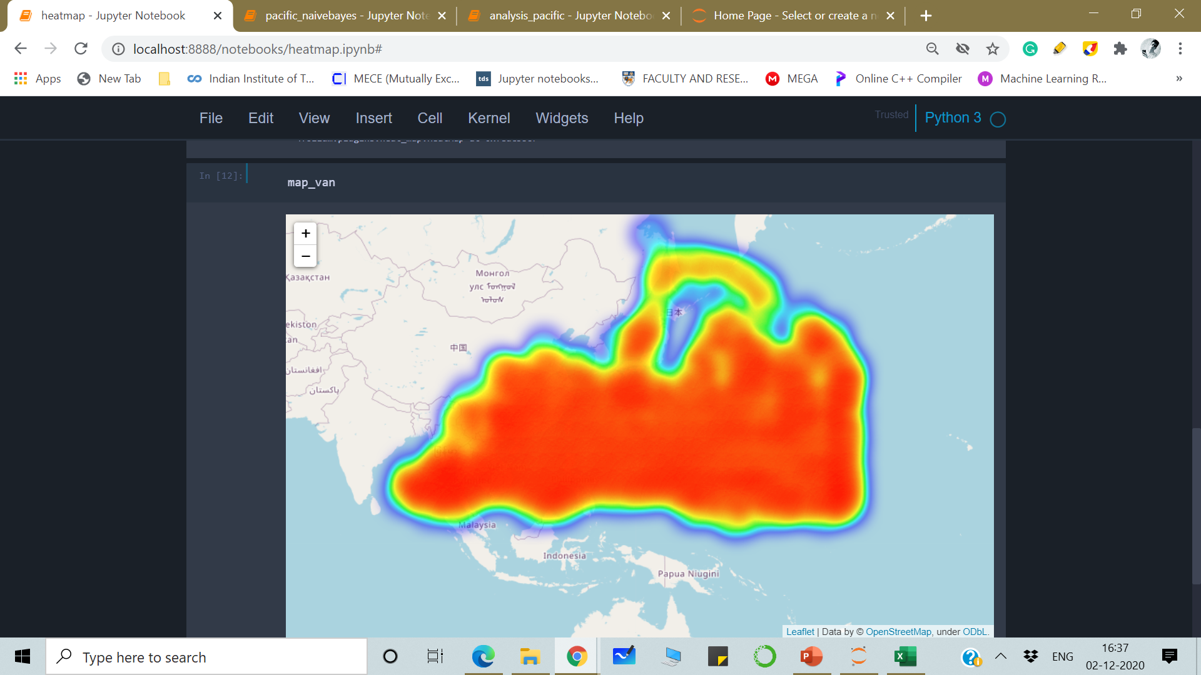
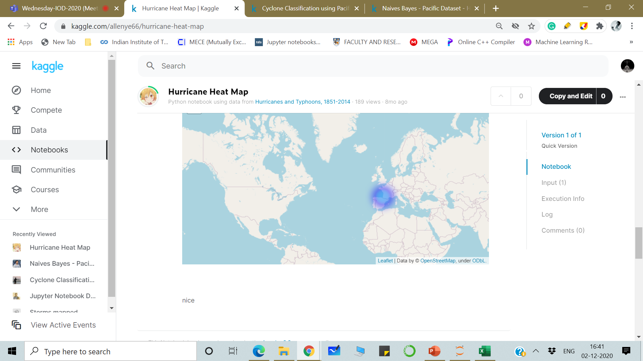
Analysis Heat map

Slide 11
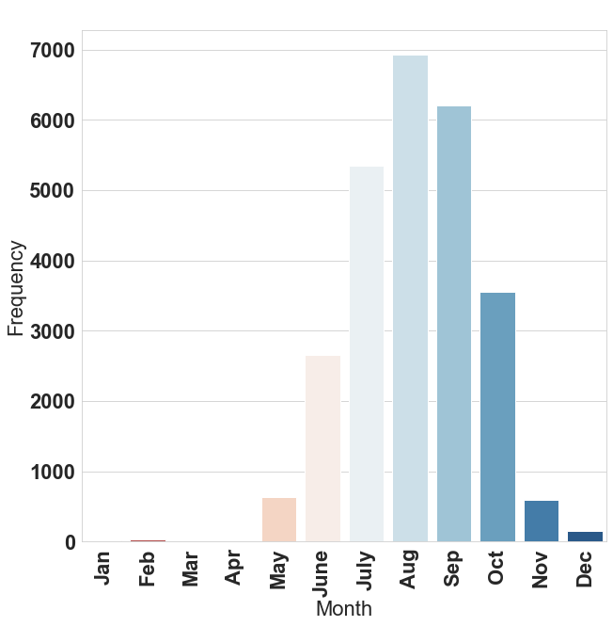
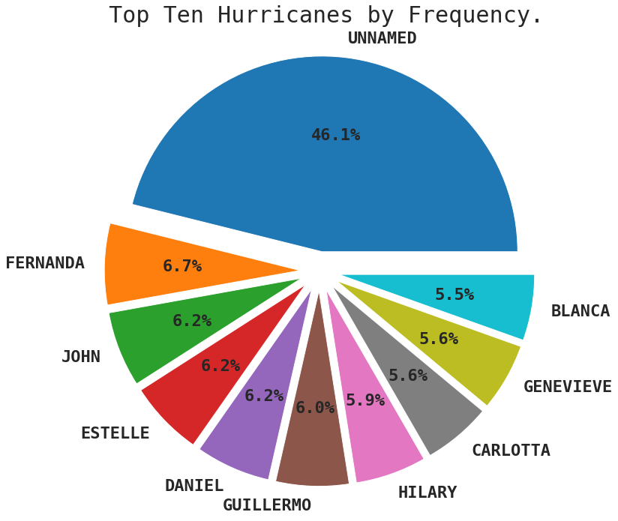
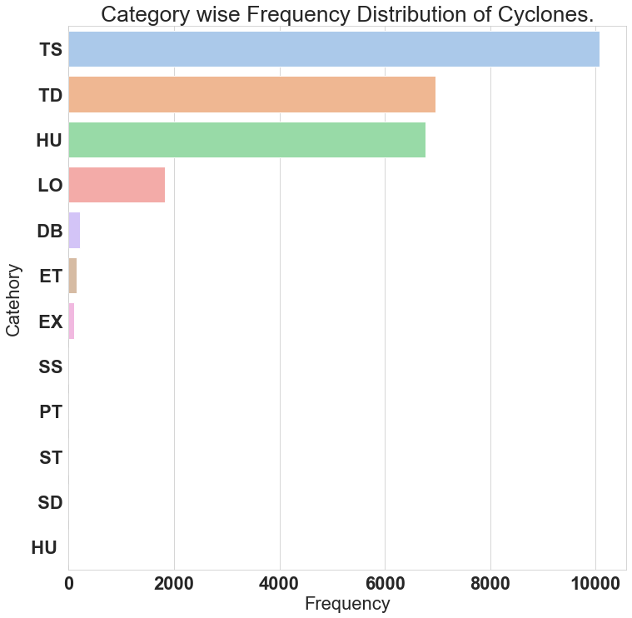
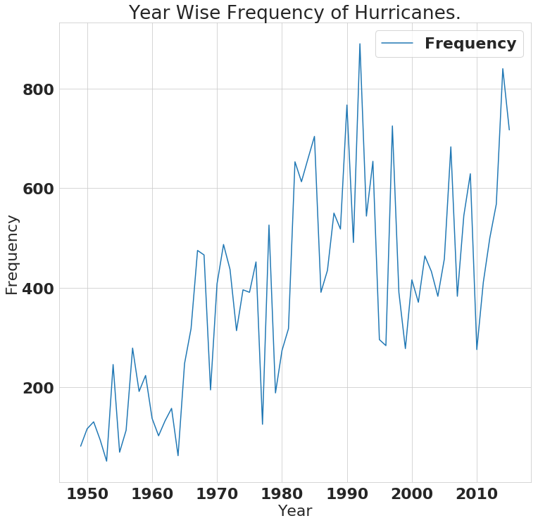
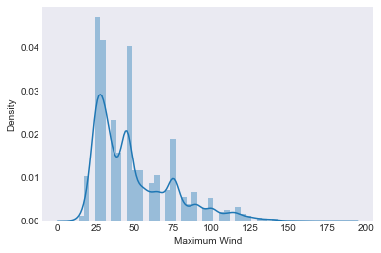
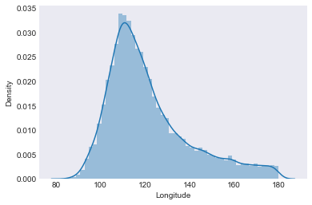
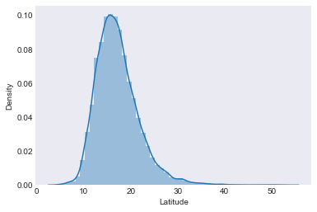

Slide 12
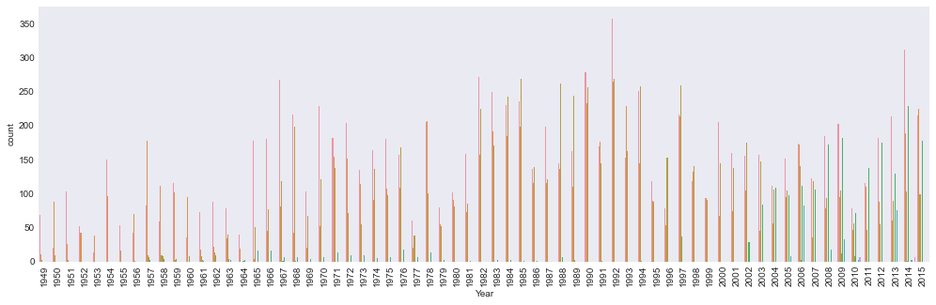
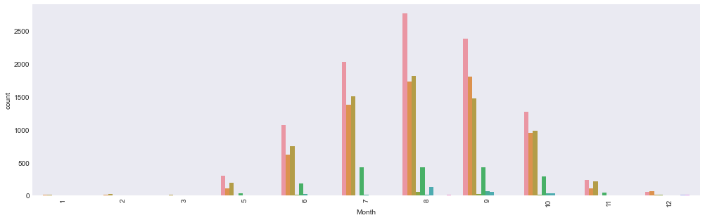
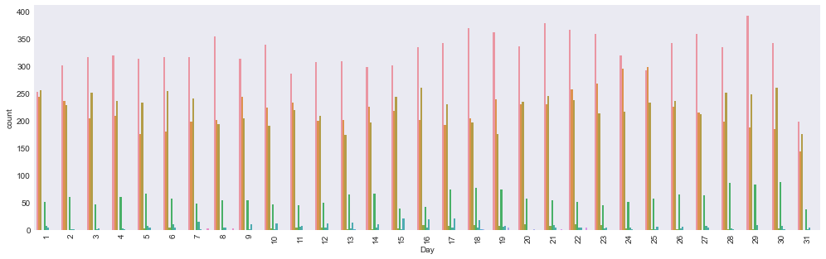

Slide 13
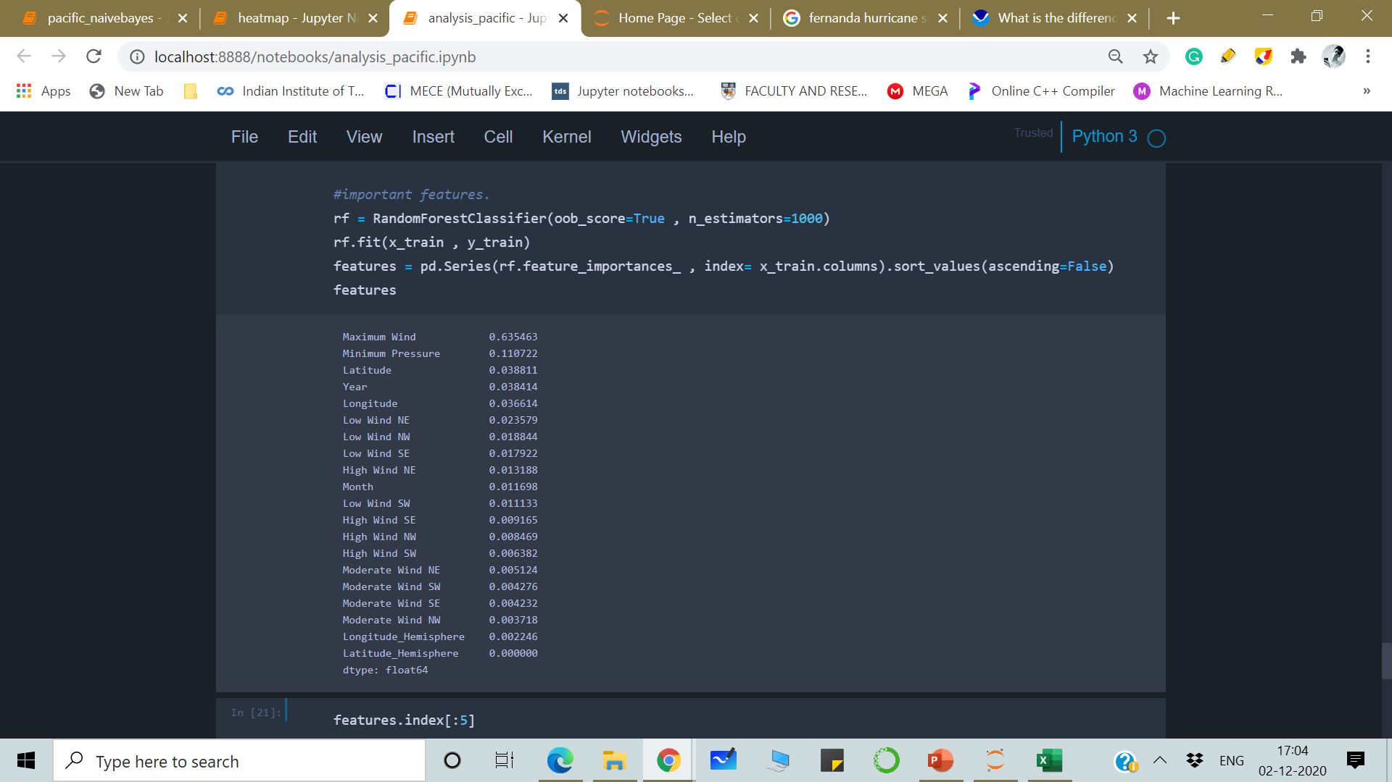
CLASSIFICATION and FEATURE SELECTION
Decision Trees
Accuracy score for Decision Tree is : 0.9651068271145011
Recall score for Decision Tree is : 0.9651068271145011
Precision score for Decision Tree is : 0.9639969870825983
Accuracy score for Decision Tree is : 0.9651068271145011
Recall score for Decision Tree is : 0.9651068271145011
Precision score for Decision Tree is : 0.9639969870825983
Before Feature selection
After Feature selection

Slide 14
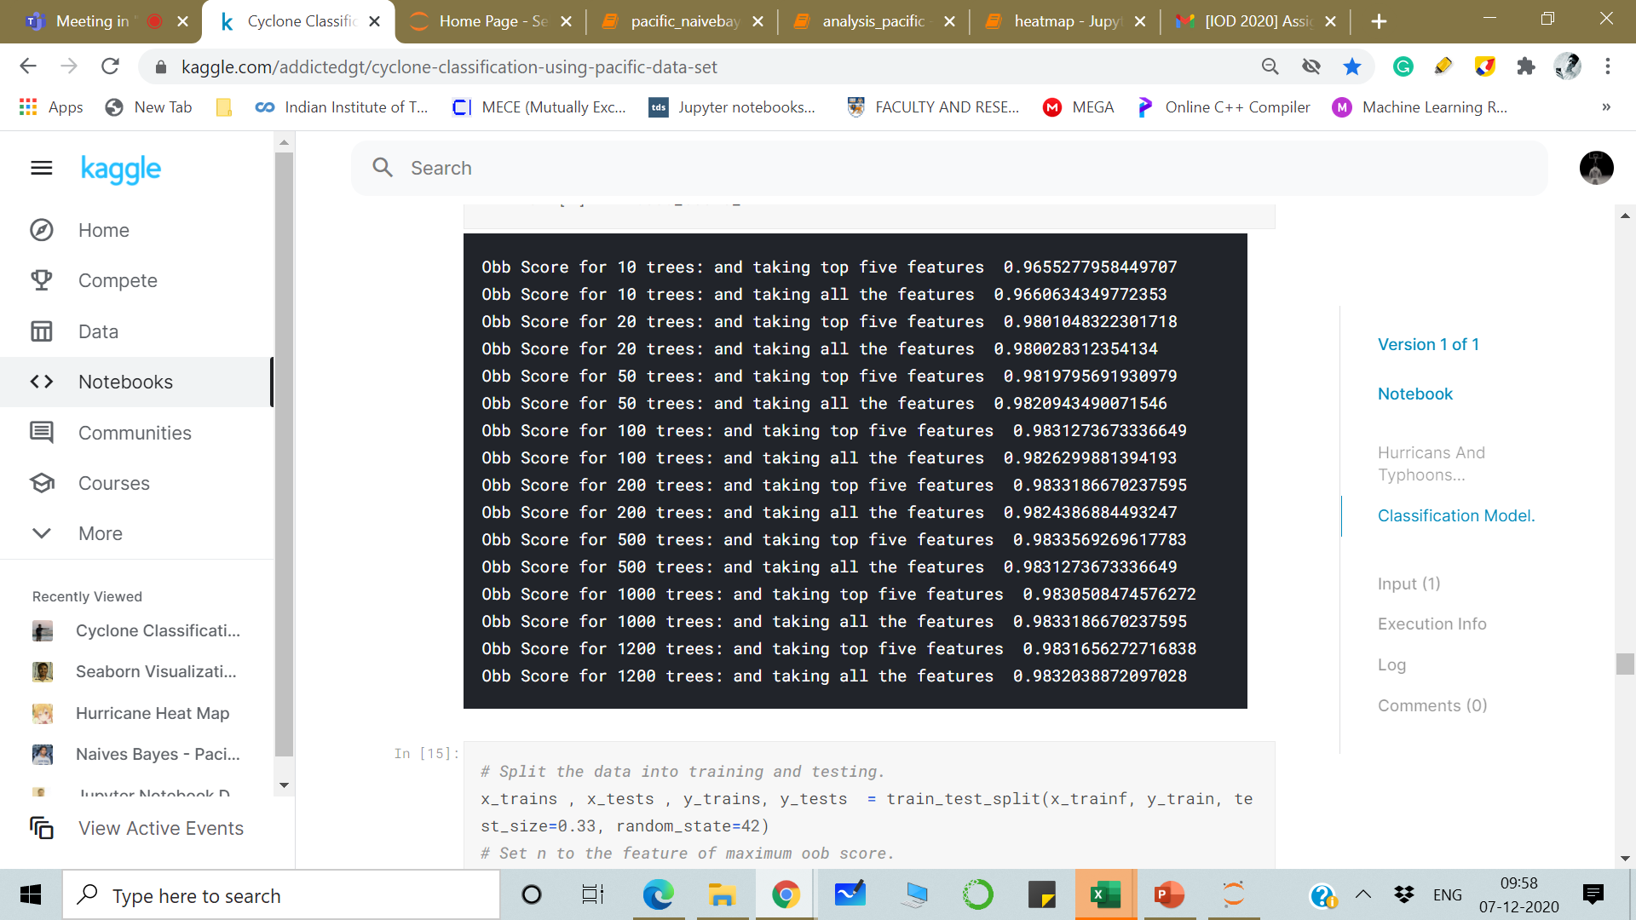
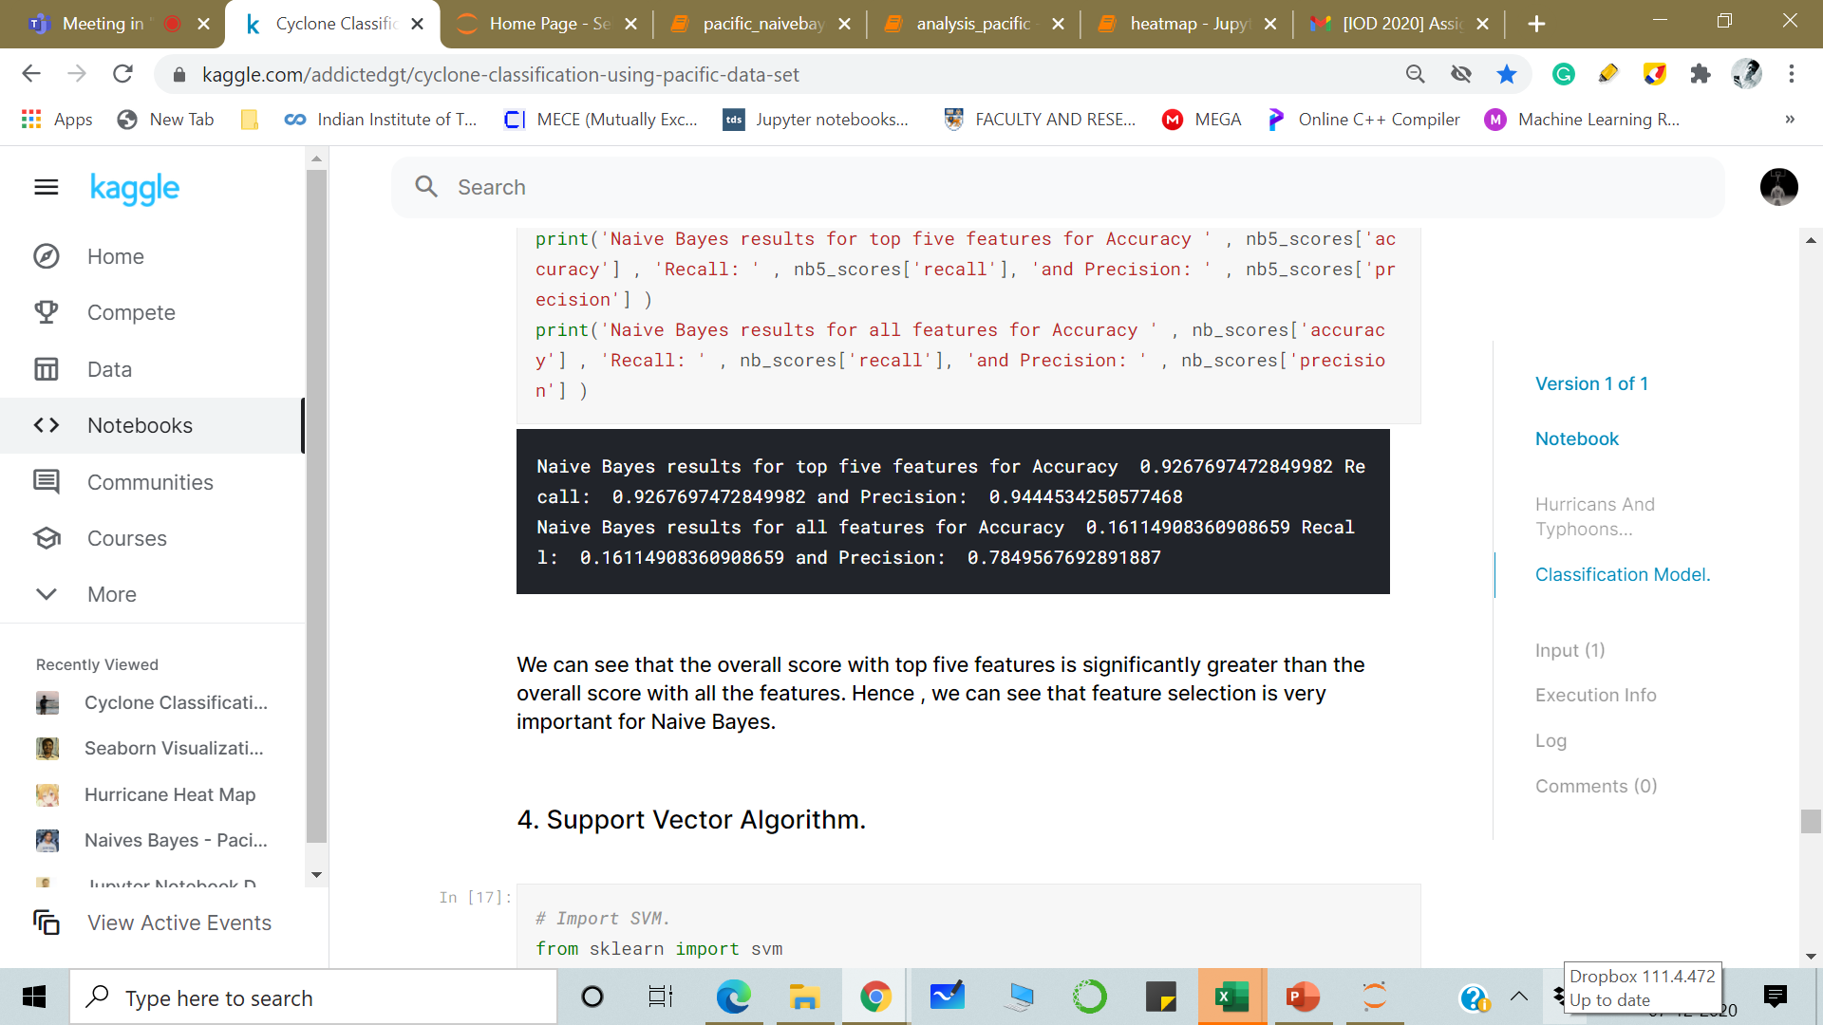
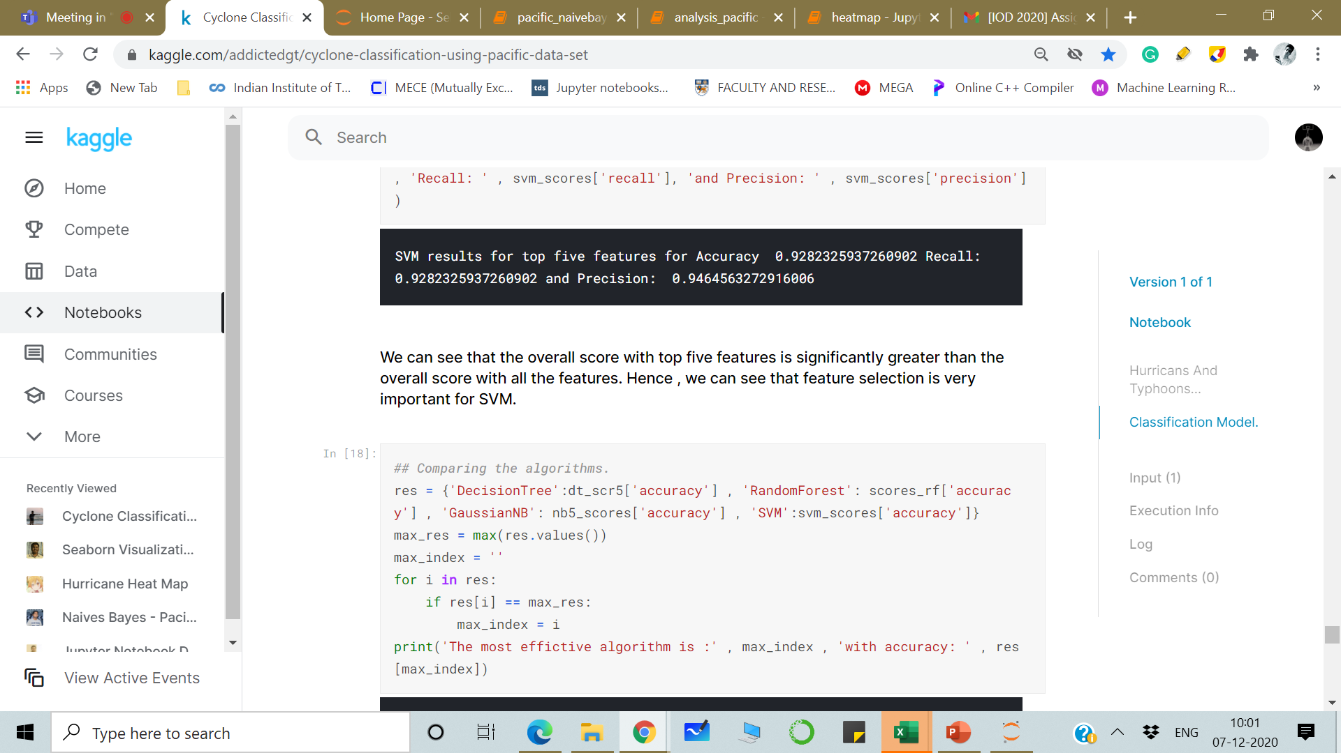
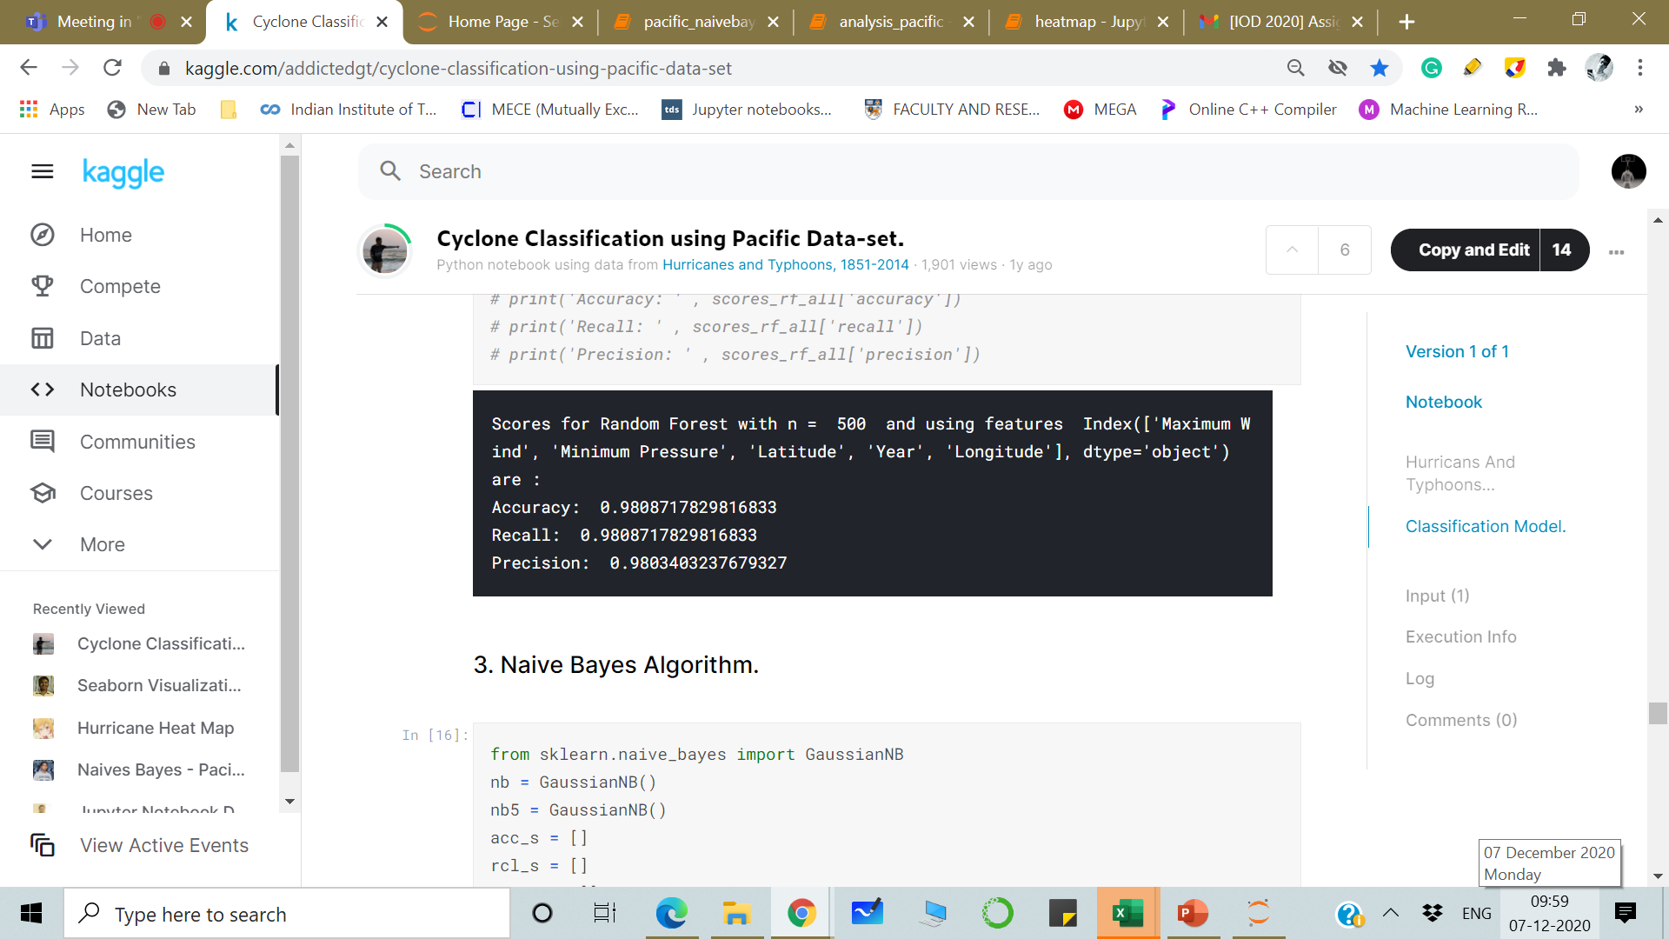
The most effective algorithm according to my analysis and feature selection is : Random Forest with accuracy: 98.087%

Slide 15
Insights
Maximum cyclone impact ( average spatial statistics of the hurricane or typhoon eye) present in Northern hemisphere around 20N and around 106 – 108 W Longitude
Most cyclones are unnamed
Maximum cyclones occur in the months of July, August and September.
The time series of Pacific hurricanes frequency in generally increasing.
The peak frequency was 1990, there was also a time series dip in 2010 followed by a sharp surge.
TS is the cyclone with highest frequency ( tropical cyclone where tropical depression intensity is less than 34 knots).
TD and HU are also relatively more frequent types of status.
Maximum Wind, Pressure , Geospatial coordinates are crucial in determining the type of cyclone.

Slide 16
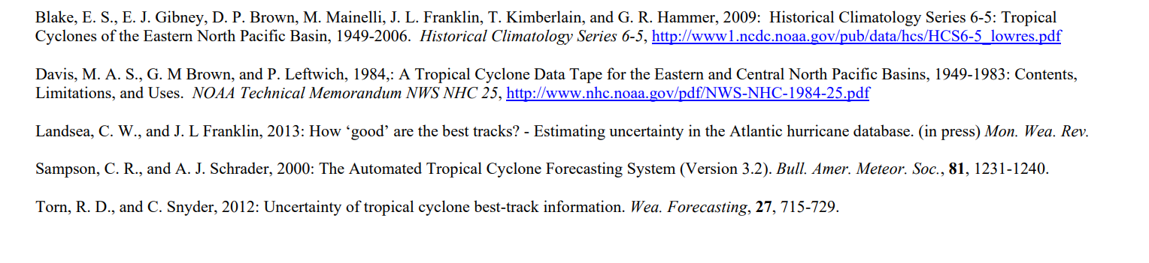
References

Slide 17
Thank you
ANALYSIS
MODEL
IMPROVING ACCURACY

